Slide 1
Introduction to CSS Tables
Styling Tables with CSS

Slide 2
What are Tables ?
Definition: Tables consists of row and columns.
Purpose: In HTML, tables are used to display tabular data.
Basic HTML Structure: `<table> <tr> <th>Header 1</th> <th>Header 2</th> </tr> <tr> <td>Data 1</td> <td>Data 2</td>
</tr> </table>`

Slide 3
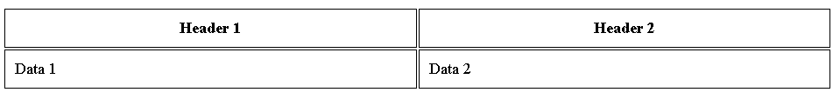
Basic CSS Styling
Adding Borders th,td { border: 1px solid black; padding: 10px; }
Output:

Slide 4
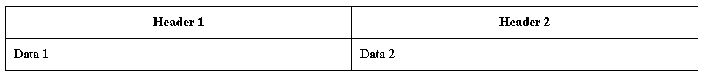
Border Collapse
Adding Borders style: table { border-collapse : collapse; }

Slide 5
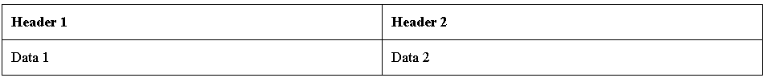
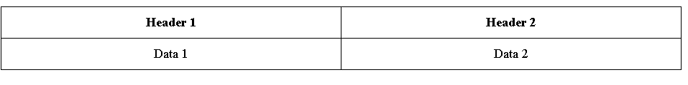
Text alignment
Aligning the text:
text-align: left;
text-align: center;

Slide 6
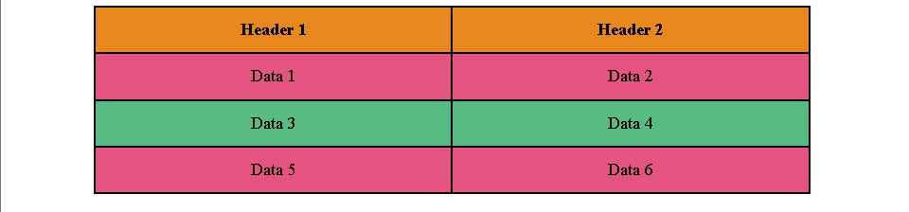
Background colors
Different colors can be added to the background with various tags.
Table background colors:

Slide 7
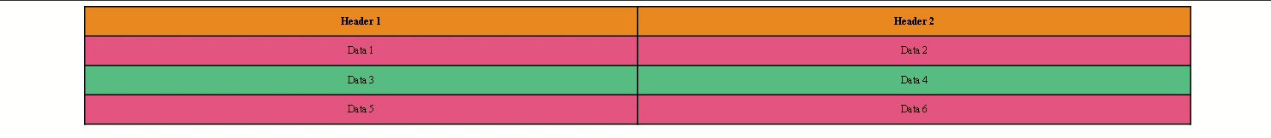
Responsive Table
The responsive table can be created with percentage or viewport units
Ex : table { width: 80%; margin: auto; }

Slide 8
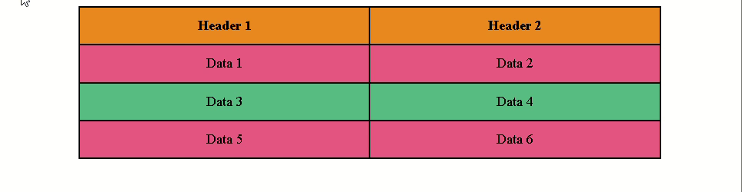
Hover Effects
tr:hover { background-color: #14080E; color: #ffffff; }

